Slide 1
Presentation brief for MCT’s
Title of presentation | Real-time Stream Processing with Stream Analytics
Presentation\Lab length | Presentation: 50 - 60 minutes Lab: 50 – 60 minutes
Audience | Data Engineers, Data Scientists, Data Professionals, Data Architects, BI Professionals, Developers
Purpose | Enable reliable messaging for Big Data applications using Azure Event Hubs Work with data streams by using Azure Stream Analytics Transform data by using Azure Stream Analytics
(think) Student key takeaways | The student should understand real-time messaging for big data applications using Azure Event Hubs The student should know how to work with data streams by using Azure Stream Analytics The student should comprehend data transformation techniques by using Azure Stream Analytics
(feel) Student desired mindset | The student may feel confusion to understand the differences between Azure Event Hubs and Azure Stream Analytics. The student may not be familiar with real-time messaging for big data applications The student may feel confusion with windowing functions techniques using Azure Stream Analytics.
(do) Student outcomes | The student should be able to articulate a one sentence description of real-time data streaming architecture The student should be able to comprehend Azure Stream Analytics and Event Hubs The student should be able to work with and transform incoming data-streams using Azure Stream Analytics
More information | For MCT course feedback, visit the Microsoft Official Courseware forum
Notes:
Instructor notes and guidance
This slide is for MCT use only, outlining the aims and objectives of this module.

Slide 2
DP-203T00:
Real-time Stream Processing with Stream Analytics
Notes:
Instructor notes and guidance
Introduce to the students that this module explores real-time stream processing using Azure Stream Analytics. At this stage, the students are being introduced to the technologies of Azure Stream Analytics, Azure Synapse Analytics and Event Hubs.
They will focus on the configurations of Azure Stream Analytics and Azure Event Hubs with Azure Synapse Analytics, as well as scripts to use for transformations using Azure Stream Analytics. They will also explore the setup for ingestion messages using Azure Event Hubs.
In the lab, we take the opportunity to let the students learn how to process streaming data with Azure Stream Analytics. They will ingest vehicle telemetry data into Event Hubs, then process that data in real time, using various windowing functions in Azure Stream Analytics. They will output the data to Azure Synapse Analytics. Finally, they will learn how to scale the Stream Analytics job to increase throughput.

Slide 3

Agenda
Lesson 01 – Enable reliable messaging for Big Data applications using Azure Event Hubs
Lesson 02 – Work with data streams by using Azure Stream Analytics
Lesson 03 – Transform data by using Azure Stream Analytics
Notes:
Instructor notes and guidance
This space has been left deliberately blank.

Slide 4
Lesson 01: Enable reliable messaging for Big Data applications using Azure Event Hubs
Notes:
Instructor notes
This space has been left deliberately blank

Slide 5
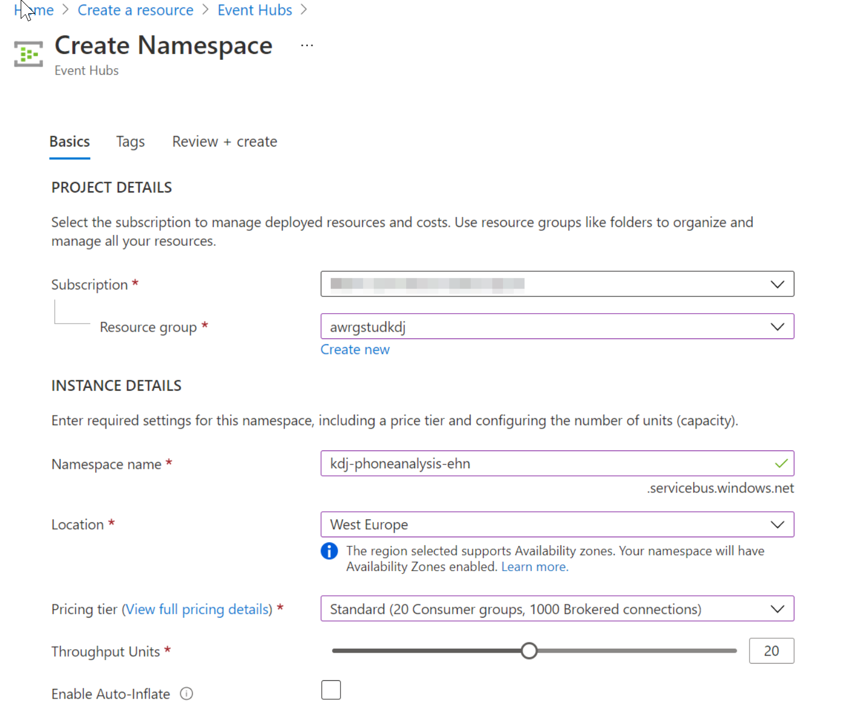
Azure Event Hubs
Azure Event Hubs is a highly scalable publish-subscribe service that can ingest millions of events per second and stream them into multiple applications
Notes:
Talking points
Azure Event Hubs is a big data streaming platform and event ingestion service. It can receive and process millions of events per second. Data sent to an event hub can be transformed and stored by using any real-time analytics provider or batching/storage adapters.
The following scenarios are some of the scenarios where you can use Event Hubs:
Anomaly detection (fraud/outliers)
Application logging
Analytics pipelines, such as clickstreams
Live dashboarding
Archiving data
Transaction processing
User telemetry processing
Device telemetry streaming
Instructor notes and guidance
Tell the students that the first step in creating event hubs is to create an Event Hub namespace as shown in the slide. It is important to distinguish between the Event Hub namespace which is the addressable name of the Event Hub, whereas the Event Hub itself is the service that processes the data. An Event Hubs namespace provides a unique scoping container, in which you create one or more event hubs. You may want to create a new namespace instead of using an existing one in one of the following scenarios:
You need an Event Hub associated with a new region.
You need an Event Hub associated with a different subscription.
You need an Event Hub with a distinct capacity allocation (that is, the capacity need for the namespace with the added event hub would exceed the 40 TU threshold and you don't want to go for the dedicated cluster)
With the namespace created, then you can create one or more event hub
Azure Event Hubs provides you with a Kafka endpoint. This endpoint enables your Event Hubs namespace to natively understand Apache Kafka message protocol and APIs. With this capability, you can communicate with your event hubs as you would with Kafka topics without changing your protocol clients or running your own clusters. Event Hubs supports Apache Kafka versions 1.0 and later.
Recommended reading for this slide
https://docs.microsoft.com/en-us/azure/event-hubs/event-hubs-about

Slide 6
Create an Event Hub
Create an event hub namespace
Create an event hub
In the Azure portal, select + Create a Resource, type Event Hubs, and then select Event Hubs from the resulting search. Then select Create
Provide a name for the event hub, and then create a resource group. Specify xx-name-eh and xx-name-rg respectively, XX- represent your initials to ensure uniqueness of the Event Hub name and Resource
Group name
Click the checkbox to Pin to the dashboard, then select the Create button
After the deployment is complete, click the xx-name-eh event hub on the dashboard
Then, under Entities, select Event Hubs
To create the event hub, select the + Event Hub button. Provide the name socialstudy-eh,
and then select Create
To grant access to the event hub, we need to create a shared access policy. Select the socialstudy-eh event hub when it appears, and then, under Settings, select Shared access policies
Under Shared access policies, create a policy with MANAGE permissions by selecting + Add. Give the policy the name of xx-name-eh-sap, check MANAGE, and then select Create
Select your new policy after it has been created, and then select the copy button for the CONNECTION STRING – PRIMARY KEY entity
Paste the CONNECTION STRING – PRIMARY KEY entity into Notepad, this is needed later in the exercise
Leave all windows open
Notes:
Talking points
The process for creating an event hub namespace and an event hub is straightforward. You should be familiar with the different pricing tiers that are available in terms of the capabilities that are offered. The following link lays out the limits of each tier
https://docs.microsoft.com/en-us/azure/event-hubs/event-hubs-quotas
In addition, the throughput capacity of Event Hubs is controlled by throughput units. Throughput units are pre-purchased units of capacity. A single throughput lets you:
Ingress: Up to 1 MB per second or 1000 events per second (whichever comes first).
Egress: Up to 2 MB per second or 4096 events per second.
This setting combined with the partitioning limits within each pricing tier can impact the performance of the event hub, so you need to choose the settings that are appropriate for the needs of the business
Instructor notes and guidance
The slide provides the instructions for creating an event hub namespace and event hubs in the Azure portal. However, you can also create any Azure service programmatically
Instructor notes and guidance
Recommended reading for this slide
https://docs.microsoft.com/en-us/azure/event-hubs/event-hubs-create
https://docs.microsoft.com/en-us/learn/modules/enable-reliable-messaging-for-big-data-apps-using-event-hubs/2-create-an-event-hub-using-azure-cli
https://docs.microsoft.com/en-us/learn/modules/enable-reliable-messaging-for-big-data-apps-using-event-hubs/3-exercise-create-an-event-hub-using-azure-cli

Slide 7
Configure applications to use Event Hubs
<name>eh
Event Hub
Queues streaming data
<name>ns
Service Bus Namespace
Send
Receive
Mobile Application
API
Notes:
Talking points
After you've created and configured your Event Hub, you'll need to configure applications to send and receive event data streams. For example, a payment processing solution will use some form of sender application to collect customer's credit card data, and a receiver application to verify that the credit card is valid. Although there are differences in how a Java application is configured, compared to a .NET application, the principles are the same for enabling applications to connect to an Event Hub, and to successfully send or receive messages.
To configure an application to send messages to an Event Hub, provide the following information, so that the application can create connection credentials:
Event Hub namespace name
Event Hub name
Shared access policy name
Primary shared access key
To configure an application to receive messages from an Event Hub, provide the following information, so that the application can create connection credentials:
Event Hub namespace name
Event Hub name
Shared access policy name
Primary shared access key
Storage account name
Storage account connection string
Storage account container name
Instructor notes and guidance
Sender and receiver applications must be configured with specific information about the Event Hub environment. You create a storage account if your receiver application stores messages in Blob Storage. If your application is hosted on GitHub, you have to clone it to your local directory. Text editors, such as nano are used to add your namespace to the application.
Recommended reading for this slide
https://docs.microsoft.com/en-us/learn/modules/enable-reliable-messaging-for-big-data-apps-using-event-hubs/5-exercise-configure-applications-to-send-or-receive-messages-through-an-event-hub

Slide 8
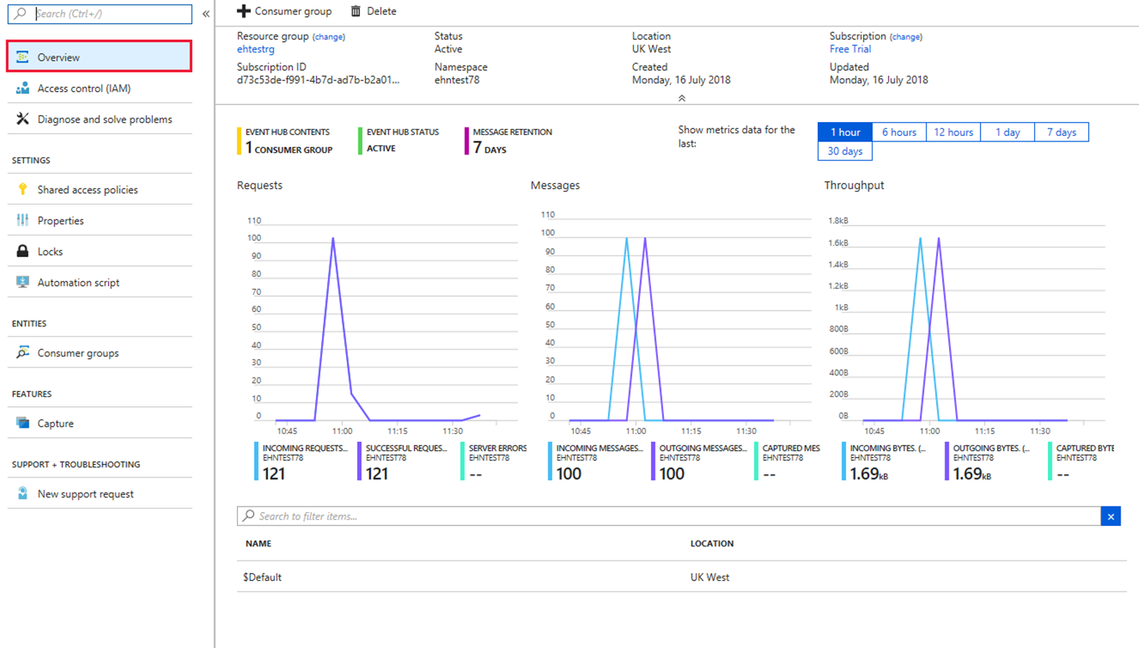
Evaluating the performance of Event Hubs
Notes:
Talking points
When using Event Hubs, you must monitor your hub to ensure that it's working as expected. The Azure portal > Overview page for your Event Hub shows message counts. These message counts represent the data (events) received and sent by the Event Hub. You can choose the timescale for viewing these events as shown in the slide graphic
Instructor notes and guidance
Azure Event Hubs keeps received messages from your sender application, even when the hub is unavailable. Messages received after the hub becomes unavailable are successfully transmitted to our application as soon as the hub becomes available.
To test this functionality, you can use the Azure portal to disable your Event Hub.
When you re-enable your Event Hub, you can rerun your receiver application, and use Event Hubs metrics for your namespace to check whether all sender messages are successfully transmitted and received.
Other useful metrics available in the Event Hubs include:
Throttled Requests: The number of throttled requests because the throughput exceeded unit usage.
ActiveConnections: The number of active connections on a namespace or Event Hub.
Incoming/Outgoing Bytes: The number of bytes sent to/received from the Event Hubs service over a specified period.
Recommended reading for this slide
https://docs.microsoft.com/en-us/learn/modules/enable-reliable-messaging-for-big-data-apps-using-event-hubs/7-exercise-evaluate-the-performance-of-the-deployed-event-hub-using-the-azure-portal

Slide 9
Lesson 02: Work with data streams by using Azure Stream Analytics
Notes:
Instructor notes
This space has been left deliberately blank

Slide 10
What are data streams
Data streams:
In the context of analytics, data streams are event data generated by sensors or other sources that can be analyzed by another technology
Data streams are used to:
Analyze data:
Continuously analyze data to detect issues and understand or respond to them
Understand systems:
Understand component or
system behavior under various conditions to fuel further enhancements
of said system
Trigger actions:
Trigger specific actions when certain thresholds are identified
Data stream processing approach:
There are two approaches. Reference data is streaming data that can be collected over time and persisted in storage as static data. In contrast, streaming data have relatively low storage requirements. And run computations in sliding windows
Notes:
Talking points
Data streams can be generated from a variety of hardware devices and software, and whilst Event Hubs are used to ingest the data streams, there still requires a technology to process the data streams in a way that can allow the data streams to be:
analyzed.
Used to understand systems
Trigger action based on thresholds
This can be performed by streaming live data, but another approach is to replay data streams that have previously been stored in an Azure Blob store
Instructor notes and guidance
It is important to make the distinction between reference data and streaming data and the impact this can have on real time analytics.
Recommended reading for this slide
https://docs.microsoft.com/en-us/learn/modules/introduction-to-data-streaming/2-understand-data-streams

Slide 11
Event processing
The process of consuming data streams, analyzing them, and deriving actionable insights out of them is called Event Processing and has three distinct components:
Event producer
Examples include sensors or processes that generate data continuously such as a heart rate monitor or a highway toll lane sensor
Event processor
An engine to consume event data streams and deriving insights from them. Depending on the problem space, event processors either process one incoming event at a time (such as a heart rate monitor) or process multiple events at a time (such as a highway toll lane sensor)
Event consumer
An application which consumes the data and takes specific action based on the insights. Examples of event consumers include alert generation, dashboards, or even sending data to another event processing engine
Notes:
Talking points
There are several services available for real-time analytics and streaming processing on Azure. Regardless of the technology used, they all work with three distinct components:
- Event Producers
- Event Processors
Event Consumers
The two main real-time analytics and streaming processing technologies on Azure are Stream Analytics, and Kafka.
Instructor notes and guidance
Take the students through the highway toll lane sensor that is used as an example on the slide to go through the three components
Recommended reading for this slide
The following documentation gives a great differentiation between the two:
https://docs.microsoft.com/en-us/azure/stream-analytics/streaming-technologies

Slide 12
Processing events with Azure Stream Analytics
Microsoft Azure Stream Analytics is an event processing engine. It enables the consumption and analysis of high volumes of streaming data in real time
Source
Ingestion
Analytical engine
Destination
Sensors
Systems
Applications
Event Hubs
IoT Hubs
Azure Blob Store
Stream Analytics Query Language
.NET SDK
Azure Data Lake
Cosmos DB
SQL Database
Blob Store
Power BI
Notes:
Talking points
Microsoft Azure Stream Analytics is an event processing engine. It enables the consumption and analysis of high volumes of streaming data in real time
It deals with data in the following process
Source
Ingestion
Analytical engine
Destination
Instructor notes and guidance
Explore the range of sources that can be used to produce data, and see if any students make use of this. It is also important to look at the difference between the various ingestion technologies. This course does not focus on IoT Hubs as there is a separate course on this, instead the focus will be on Event Hubs.
When going through the Analytical engine, focus on the Stream Analytics Query language. Tell the students if they are familiar with Transact-SQL then they will feel comfortable with the language, and they will explore an example in the lab.
Recommended reading for this slide
https://docs.microsoft.com/en-us/learn/modules/introduction-to-data-streaming/4-process-events-azure-stream-analytics

Slide 13
Lesson 02: Transform data by using Azure Stream Analytics
Notes:
Instructor notes
This space has been left deliberately blank

Slide 14
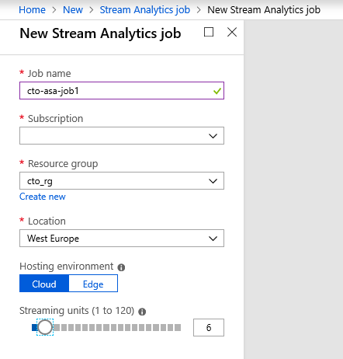
Create Stream Analytics service
Job name
Subscription
Resource group
Location
Notes:
Talking points
Microsoft Azure Stream Analytics is an event processing engine. It enables the consumption and analysis of high volumes of streaming data in real time
It deals with data in the following process
Source
Ingestion
Analytical engine
Destination
Instructor notes and guidance
You can either use this screenshot to go through the settings for Azure Stream Analytics, alternatively, log into the Azure portal to see the latest GUI version. Use this to drive the conversation around the Azure Stream Analytics settings.
If possible, it is recommended that you demonstrate this.
Recommended reading for this slide
https://docs.microsoft.com/en-us/learn/modules/ingest-data-streams-with-azure-stream-analytics/

Slide 15
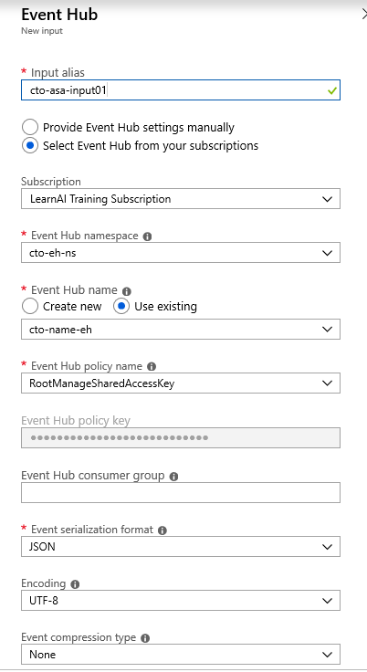
Create a Stream Analytics Job input
Notes:
Talking points
You configure Azure Event Hubs as an input for Azure Stream Analytics to ingest streaming data. Event Hubs acts as the entry point to a near-real-time analytics pipeline built on Azure Event Hubs, Azure Stream Analytics, and Power BI.
Instructor notes and guidance
You can either use this screenshot to go through the settings for Azure Stream Analytics, alternatively, log into the Azure portal to see the latest GUI version. Use this to drive the conversation around the Azure Stream Analytics settings.
If possible, it is recommended that you demonstrate this.
Recommended reading for this slide
https://docs.microsoft.com/en-us/learn/modules/ingest-data-streams-with-azure-stream-analytics/4-exercise-create-streaming-data-input

Slide 16
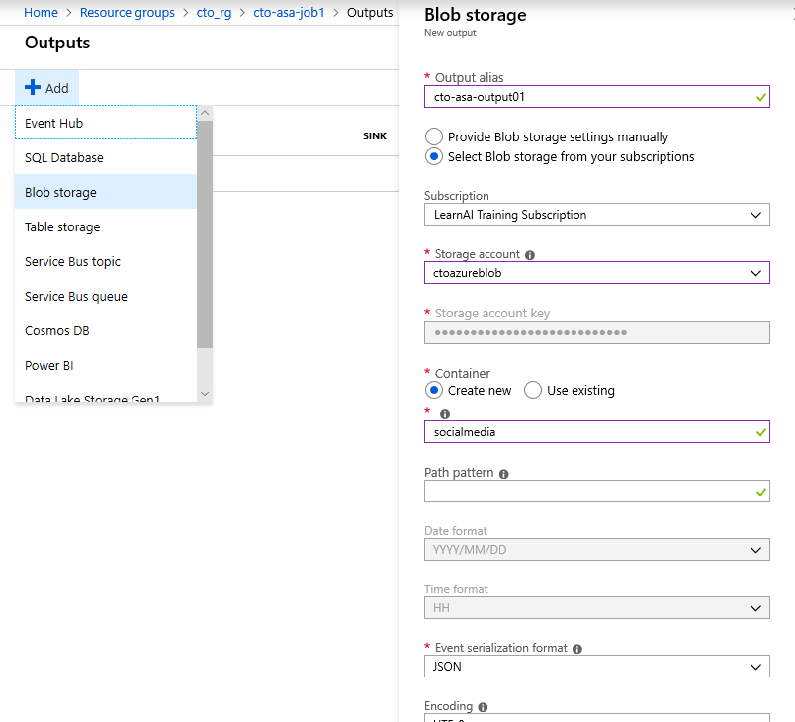
Create a Stream Analytics Job output
Notes:
Talking points
you configure an Azure Stream Analytics output for Power BI and a second output for Azure Synapse Analytics. Power BI provides a platform for visualizing and analyzing aggregated data in a near-real-time analytics pipeline built on Azure Event Hubs, Azure Stream Analytics, and Power BI.
Instructor notes and guidance
You can either use this screenshot to go through the settings for Azure Stream Analytics, alternatively, log into the Azure portal to see the latest GUI version. Use this to drive the conversation around the Azure Stream Analytics settings.
If possible, it is recommended that you demonstrate this.
Recommended reading for this slide
https://docs.microsoft.com/en-us/learn/modules/ingest-data-streams-with-azure-stream-analytics/5-exercise-create-power-bi-output

Slide 17
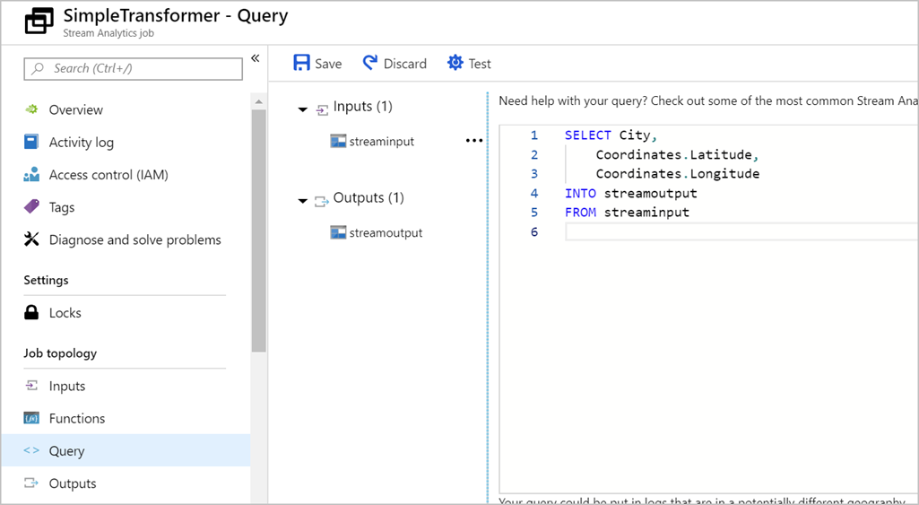
Transform data by using Azure Stream Analytics
Declarative SQL like language
Contains testing capabilities
Performs aggregations over windows of time
Notes:
Talking points
Azure Stream Analytics enables you to develop massively parallel Complex Event Processing (CEP) pipelines with simplicity. In these pipelines you are enabled to author powerful, real-time analytics solutions using very simple, declarative SQL like language with embedded support for temporal logic. You can, for example, perform aggregations on the telemetry data over certain windows of time. With the test feature within Azure Stream Analytics, you can easily test the query if the output is what you expected.
In Azure Stream Analytics, we call this pipeline a job, which is a unit of execution.
A Stream Analytics job pipeline consists of three parts:
- An input that provides the source of the data stream.
- A transformation query that acts on the input. For example, a transformation query could aggregate the data over windows of time
- An output that identifies the destination of the transformed data.
Instructor notes and guidance
This slide will showcase the features to query and transform data, but only at a product level of Azure Stream Analytics.
In the lab, the student will perform window aggregations by using the declarative SQL language, and see how these transform the data by visualizing it in in Power BI.
Recommended reading for this slide
Transform data by using Azure Stream Analytics - Learn | Microsoft Docs

Slide 18
Using Windowing functions with Azure Stream Analytics
Performing operations on the data contained in temporal windows is a common pattern. Stream Analytics has native support for windowing function including
Tumbling
Hopping
Sliding
Session
Tumbling window functions are used to segment a data stream into distinct time segments and perform a function against them.
For example, tell me the count of tweets per time zone every 10 seconds
Hopping window functions hop forward in time by a fixed period.
For example, every 5 seconds, give me the count of tweets for the last 10 seconds
Sliding windows, output events only for points in time when the content of the window actually changes.
For example, give a count of all tweets which are tweeted more than 10 times on a given topic
Session window functions group events that arrive at similar times, filtering out periods of time where there is no data.
For example, give the count of tweets that occur within 5 minutes of each other
Notes:
Talking points
In time-streaming scenarios, performing operations on the data contained in temporal windows is a common pattern. Stream Analytics has native support for windowing functions, enabling developers to author complex stream processing jobs with minimal effort.
There are five kinds of temporal windows to choose from: Tumbling, Hopping, Sliding, Session, and Snapshot windows. You use the window functions in the GROUP BY clause of the query syntax in your Stream Analytics jobs. You can also aggregate events over multiple windows using the Windows() function.
All the windowing operations output results at the end of the window. Note that when you start a stream analytics job, you can specify the Job output start time and the system will automatically fetch previous events in the incoming streams to output the first window at the specified time; for example when you start with the Now option, it will start to emit data immediately. The output of the window will be single event based on the aggregate function used. The output event will have the time stamp of the end of the window and all window functions are defined with a fixed length.
Instructor notes and guidance
Share with the students that you are covering the four common types of windowing functions that are used in the slide
Recommended reading for this slide
https://docs.microsoft.com/en-us/learn/modules/ingest-data-streams-with-azure-stream-analytics/6-describe-windowing-functions
https://docs.microsoft.com/en-us/azure/stream-analytics/stream-analytics-window-functions

Slide 19
Windowing functions examples with Azure Stream Analytics
Tumbling
Hopping
Sliding
Session
SELECT
Timezone,
Count(*) as Count
FROM
TwitterStream
TIMESTAMP BY
CreatedAt
GROUP BY
Timezone
TUMBLINGWINDOW (second, 10)
SELECT
Timezone,
Count(*) as TotalTweet
FROM
TwitterStream
TIMESTAMP BY
CreatedAt
GROUP BY
Topic
HOPPINGWINDOW (second, 10, 5)
SELECT
Topic,
Count(*)
FROM
TwitterStream
TIMESTAMP BY
CreatedAt
GROUP BY
Topic
SLIDINGWINDOW (second, 10)
HAVING COUNT(*) > 10
SELECT
Timezone,
Count(*)
FROM
TwitterStream
TIMESTAMP BY
CreatedAt
GROUP BY
Topic
SESSIONWINDOW (minute 5, 10)
Notes:
Talking points
This slide is a following on from the previous slide that shows the code behind the examples
Instructor notes and guidance
Ask the students to look out for the type of windowing functions they will be using in the last two labs
Recommended reading for this slide
https://docs.microsoft.com/en-us/learn/modules/ingest-data-streams-with-azure-stream-analytics/7-exercise-create-query-using-tumbling-windows
https://docs.microsoft.com/en-us/azure/stream-analytics/stream-analytics-window-functions

Slide 20
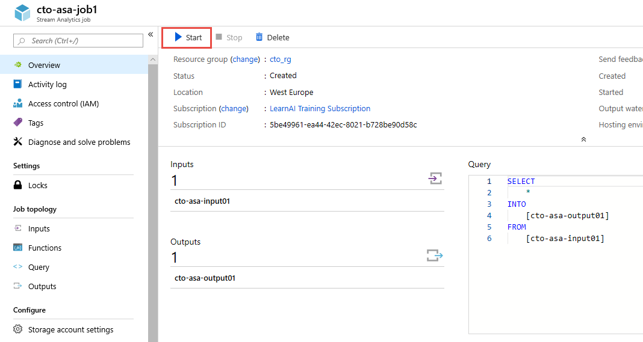
Start a Stream Analytics Job
Notes:
Talking points
This slide shows the location of where you start the Stream Analytics Service
Instructor notes and guidance
You can either use this screenshot to go through the steps required to start an Azure Stream Analytics Job, alternatively, log into the Azure portal to see the latest GUI version.
Recommended reading for this slide
https://docs.microsoft.com/en-us/azure/stream-analytics/stream-analytics-window-functions

Slide 21
Review questions
Q01 – Which technology typically provide an ingestion point for data streaming in an event processing solution that uses static data as a source?
A01 – Azure Blob storage
Q02 – Which three parts consist of an Azure Stream Analytics job pipeline
A02 – An input, a transformation query, and an output
Q03 – What query language does Azure Stream Analytics use?
A03 – SAQL
Notes:
Instructor notes and guidance
This space has been left deliberately blank

Slide 22
Lab: Real-time Stream Processing with Stream Analytics
Notes:
Instructor notes and guidance
This space has been left deliberately blank

Slide 23
Lab overview
This lab teaches you how to process streaming data with Azure Stream Analytics. You will ingest vehicle telemetry data into Event Hubs, then process that data in real time, using various windowing functions in Azure Stream Analytics. You will output the data to Azure Synapse Analytics. Finally, you will learn how to scale the Stream Analytics job to increase throughput.
Lab objectives
After completing this lab, you will be able to:
Use Stream Analytics to process real-time data from Event Hubs
Use Stream Analytics windowing functions to build aggregates and output to Synapse Analytics
Scale the Azure Stream Analytics job to increase throughput through partitioning
Repartition the stream input to optimize parallelization
Notes:
Instructor notes and guidance
In the lab, we take to opportunity to explore how to process streaming data with Azure Stream Analytics. The student will ingest vehicle telemetry data into Event Hubs, then process that data in real time, using various windowing functions in Azure Stream Analytics. The data will be outputted to Azure Synapse Analytics. Finally, the student will learn how to scale the Stream Analytics job to increase throughput.
In exercise 1, here the students will be configuring the services, they will configure Event Hubs, Azure Synapse Analytics and Azure Stream Analytics.
In exercise 2, the students will focus on visualizing the streaming data, students will run the data generator in order to receive data, will create the Power BI dashboard that will showcase the generated data, and will view the aggregated data in Azure Synapse Analytics.

Slide 24













Lab 14 Overview
asacosmosdb<unique_suffix>
CosmosDB
Campaign Info
Azure Databricks
asagadatalake<unique_suffix>
Eventhub<suffix>
Cluster
Azure Data Lake
wwi-02
Event Hub
Vehicle data
Products (parquet)
dp203sql<unique_suffix>
asa<suffix>
Stream Analytics
Aggregated and anomaly
Vehicle data
SourceDB
Azure Synapse Analytics
Dedicated SQL Pool (SQLPool1)
Built-In Serverless SQL Pool
Apache Spark pool
Pipelines and
Dataflows
Power BI
asagaworkspace<unique_suffix>
Notes:
This slide is an optional slide that you can use to show a high level overview of the technologies used in the lab.
This lab teaches you how to process streaming data with Azure Stream Analytics. You will ingest vehicle telemetry data into Event Hubs, then process that data in real time, using various windowing functions in Azure Stream Analytics. You will output the data to Azure Synapse Analytics. Finally, you will learn how to scale the Stream Analytics job to increase throughput.

Slide 25
Lab review
Q01 – How can you extend Azure Stream Analytics with custom code?
Q02 – What is Azure Event Hubs?
Q03 – What does the following command do: GROUP BY TumblingWindow(Duration(second, 2))
Notes:
Answers
Question 1 - Using JavaScript User Defined Functions
Question 2 - Azure Event Hubs is a big data pipeline that can ingest millions of events per second.
Question 3 - The query groups a variable over a two second duration using the Tumbling Window function

Slide 26
Module summary
In this module, you have learned about:
Azure Stream Analytics
Azure Event Hubs
Windowing Functions
Partitioning
Azure Synapse Analytics
Next steps
After the course, consider visiting the website that explores a [Azure Stream Analytics solution patterns] Azure Stream Analytics solution pattern and the associated documentation that goes into more depth about this architecture.
Notes:
Instructor notes and guidance
The next steps is suggested post course learning materials to reinforce what they have learned in the module.

Slide 27
Closing slide
Notes:
Instructor notes and guidance
This space has been left deliberately blank

